Slide 1
Day 10 – JavaScript Fundamental

Slide 2
Recap
Array
Object
Destructuring
Spread and Rest Operation

Slide 3
DOM
Document Object Model
Structured representation of html documents
Allow JS to access html elements and styles to manipulate them

Slide 4
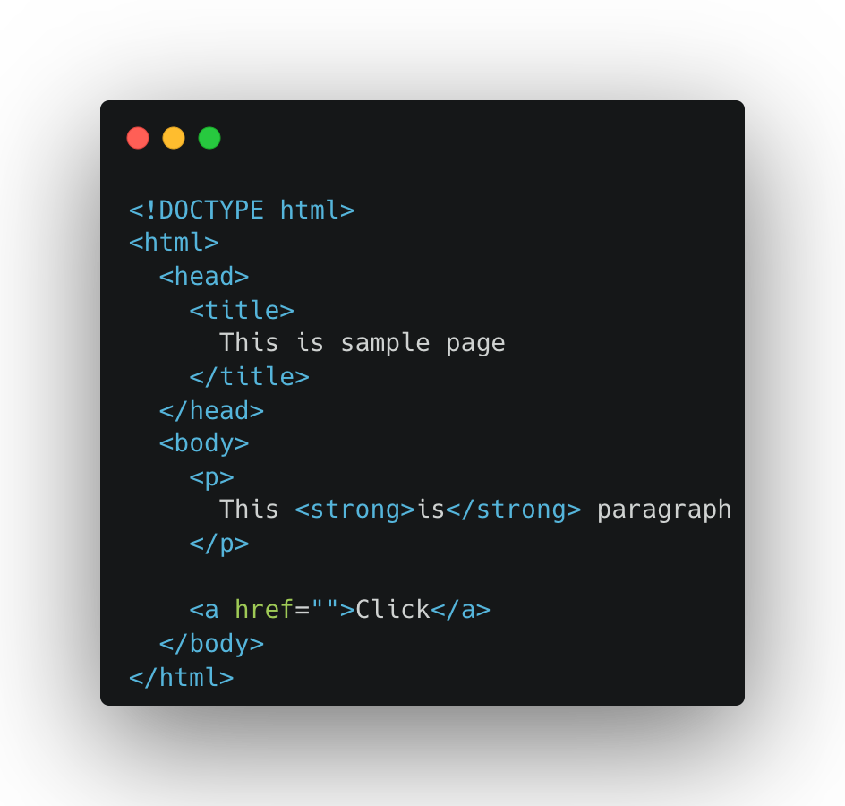
Dom Tree Structure
document
html
head
body
title
p
a
This is sample page
This …
strong
click
is

Slide 5
Dom
Document.querySelector()

Slide 6
Eventhandler
Button
Keyboard

Slide 7
Exercise
Guess a Number
Modal
Pig Game

Slide 8
Feedback
What went well?
What went wrong?
What did you learn?

Slide 9
Credit
https://carbon.now.sh/
https://ascii.co.uk/art
https://appbrewery.com/

Slide 10
I believe that you learn the most if you don’t learn alone but find learning partners and other people with similar interest. - Unknown

